Slide 1

A Guide for Parents
Year 1 Phonics Screening Check
Thursday, 2nd February 2017

Slide 2
Aims
To understand what the Y1 Phonics Screening Check is all about
How we are supporting your children
How you as parents/ families can help
To answer any of your questions

Slide 3
What is phonics?
Children are taught to read by breaking down words into separate sounds or ‘phonemes’ (segmenting). They are then taught how to blend these sounds together to read the whole word.
There are 44 sounds. These are shown on the complex speed sounds chart.
Children are encouraged to use these sounds to read, spell and write in other lessons.
Notes:
Complex speed sounds chart on display. 140 different letter combinations – the same phoneme can be represented in different ways.

Slide 4
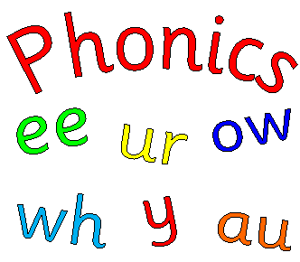
What is the Phonics Screening Check?
Children in Year 1 throughout the country will be taking part in the phonics screening check during the week commencing 12th June 2017.
Children in Year 2 will also take the check if they did not achieve the required standard when in Year 1 or have not taken the test before.
The check is very similar to tasks children already complete in phonics lessons.

Slide 5
What happens during the screening?
The check contains 40 words. Each child sits one-to-one and reads with the teacher. The 40 words are divided into two sections – one with simple word structures of three or four letters, and one with more complex word structures of five or six letters.
The check will take approximately 10 minutes per child, although all children are different and will complete the check at their own pace.
The list of words the children read are a mixture of 20 real words and 20 pseudo words (nonsense words)

Slide 6
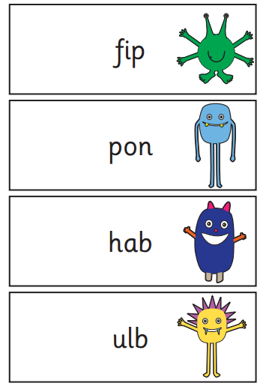
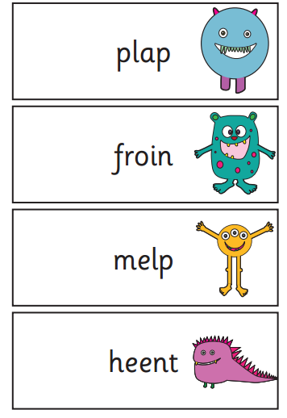
Pseudo Words (Nonsense Words)
The pseudo words will be shown to your child with a picture of an alien. This provides the children with a context for the pseudo word which is independent from any existing vocabulary they may have.
Pseudo words are included because they will be new to all pupils; they do not favour children with a good vocabulary knowledge or visual memory of words.
Video of screening check

Slide 7
The Results
Your child will be scored against a national standard, and the main result will be whether or not they are working towards the expected standard or have met the expected standard. The threshold mark is not available until all marks are sent in nationally to get a benchmark.
For the past four years, the "pass threshold" was 32, which means children had to read at least 32 words out of 40 correctly.
You will be told how your child scored. If your child’s score falls below the standard, they will be given extra phonics help and can re-take the phonics screening check in Year 2.
How are the results used?
Results from the check will be used by the school at analyse our own performance and for Ofsted to use in inspections.
The results also help us to identify which children may need extra phonics teaching in Year 2.

Slide 8
How will we support your child?
Daily phonics lessons
Differentiated tasks
Up to date training for all staff
Sending home spellings weekly to learn to read and spell. This helps to consolidate sounds taught in school
Sending home examples of pseudo words to practise
On going assessments every half term of sounds and tricky words
Practice tests so that your child knows what to expect
Interventions to boost gaps throughout the year

Slide 9
How can you help at home?
Read as much as possible to and with your child.
Work at your child’s pace.
Always be positive and give lots of praise and encouragement.
If your child is struggling to decode a word, get them to say each sound in the word from left to right and blend them together – ‘sound and blend’.
Discuss the meaning of words if your child does not know what they have read.
Play lots of phonics games with your child, e.g. Phonics Play http://www.phonicsplay.co.uk/
Visit https://www.oxfordowl.co.uk/home/reading-owl/expert-help/home/reading-site/expert-help/phonics-made-easy for hints and tips on how to help your child in the most effective way.
Remember!
Phonics is not the only thing needed to become a fluent reader. Keep asking questions about books and encouraging discussion.
Notes:
We will make this PowerPoint available on the school website.

Slide 10


Questions

