Slide 1
Year 6 Kingfishers

Slide 2
Aims:
Weekly timetable
Reading Challenge and Top 100 books
Homework
Parent helpers
School Journey
SATs
Questions

Slide 3
Weekly timetable
 | 9-10 | 10-11 | 11-11:15 | 11:15-12:15 | 12:15-1:15 | 1:15-2:15 |  | 2:15 - 3 |  | 3-3:25
Monday | SPaG (spelling test) | Reading | B | Maths | L | Leadership time: Computing (Mrs Blake) and P.E. (Mr Ryan) |  |  |  | KS2 assembly (3pm)
Tuesday | Arithmetic | Writing | R | Maths | U | French (Madame Iqbal) | Music (Mrs Bloomfield) |  | P.E.
Wednesday | Reading | Writing | E | Maths | N | Science |  |  |  | Music assembly (3pm)
Thursday | Writing | SPaG | A | Maths | C | PPA (Mrs Hill) R.E. and Art/D and T |  |  |  | Stars assembly (3pm)
Friday | Reading | Writing | K | Maths | H | History/ Geography |  | PSHE |  | Whole sch. Assembly (2:45pm)

Slide 4
Reading Challenge

Slide 5
Suggested 100 books to read by Year 6
There is a real buzz in the class around reading which is
fantastic!
I want to encourage the love of reading for many reasons:
It is a wonderful thing to do!
It is a life skill and transferable across all subjects
To improve the children’s vocabulary (this is always an area for improvement in the SATs reading paper)
To improve the children’s writing
To improve the children’s spelling
Please can you help us in encouraging children to read daily and to get their reading records signed. Please also ask your children questions about what they are reading to ensure understanding.

Slide 9
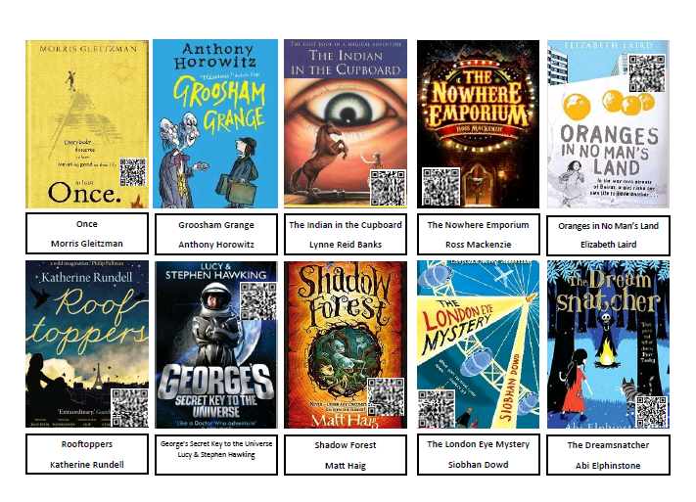

Slide 11
Home learning
Home learning will be given out by Friday. You can also find the home learning sheet uploaded on the school website by Wednesday (on our class page).
We will have a spelling test every Monday morning. Every fortnight the children will repeat the arithmetic test on Tuesdays.
Please also focus on times tables (the new curriculum expectation (as of 2014) is knowing up to 12x12 by end of year 4..!). The children should know their own personal maths target. The children will be tested on their individual times table target twice a week.
Please also talk to your child about the time and ask them what the time is (both analogue and digital clock). E.g. ‘You can watch TV for 15 minutes. What time do you have to turn it off?’

Slide 12
Parent helpers/class reps
Readers/maths target practice
Trip helpers (with DBS check)
Share your interests/profession/info that links with our topic (WW2 this term) –we are currently planning a trip to a local care home where the children will have the opportunity to discuss WW2 with people who had first-hand experience (permission letter to follow shortly).
Christmas fair (stall)
Year 6 disco (July)
Summer fair (stall)
Yearbook/leavers’ hoodies

Slide 13
School Journey – Hindleap Warren
Mon 30th October 2017 – Friday 3rd November 2017
Thank you to those of you who have already paid. Total cost = £295. Please continue to pay with cash in a named envelope or online.
If you are having difficulty paying, please speak to me so that we can help you to make alternative arrangements. We are very happy to help those families who are in need. You can spread the cost over time to make it easier to manage if necessary.
The equipment list and medical form will be sent home in the next couple of weeks.

Slide 14
SATs
SATs week
Monday 14th May 2018 – Thursday 17th May 2018
The papers the children will be taking
Reading comprehension
SPaG (spelling, punctuation and grammar)
Maths - Arithmetic (paper 1) and Maths Paper 2, Maths Paper 3

