Slide 1
Year 6 Residential Journey to Hindleap Warren
December 2nd – 6th 2019
Depart Monday at 9.00 from school
Return Friday at 3.30 to school

Slide 2
Hindleap Warren
High in the Ashdown Forest, set in 300 acres of woodland and wilderness, just over an hour from London, Hindleap Warren Outdoor Education Centre creates opportunities for personal and social development that are second to none.
Outdoor education challenges young people, encouraging and enabling them to reach out beyond that which is familiar and comfortable. The sense of adventure it instills and the team-work it inspires, help young people come together, win new confidence and gain invaluable education for life.

Slide 3
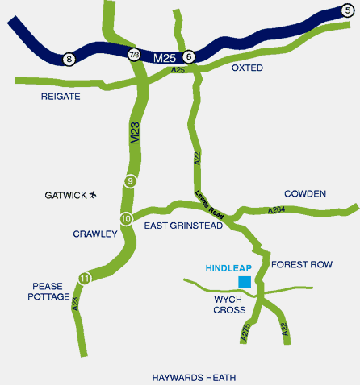
Location

Slide 4
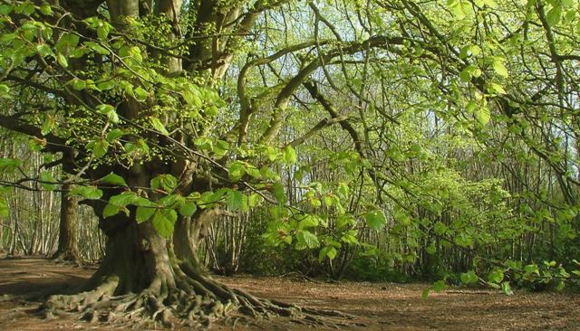
Our Grounds
Notes:
4

Slide 5
About Hindleap Warren
Each group of children will have an assigned instructor for the week.
A Darell staff member will also be assigned to each group.
Children are carefully supervised at all times.
Darell rooms are situated on a locked corridor.
You will be in a room with 3 or 4 other children.
Children are not permitted to visit other rooms.
We will do our best to have you stay with at least one of your chosen friends.

Slide 6
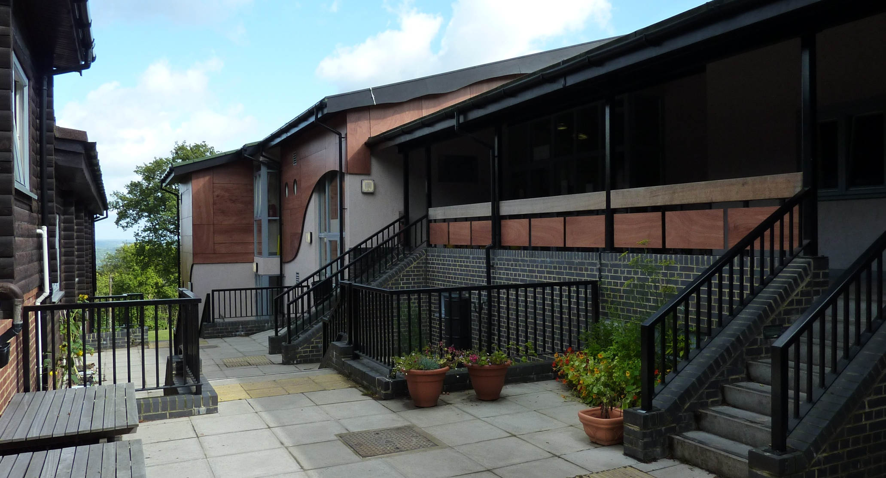
Hindleap Accommodation

Slide 7
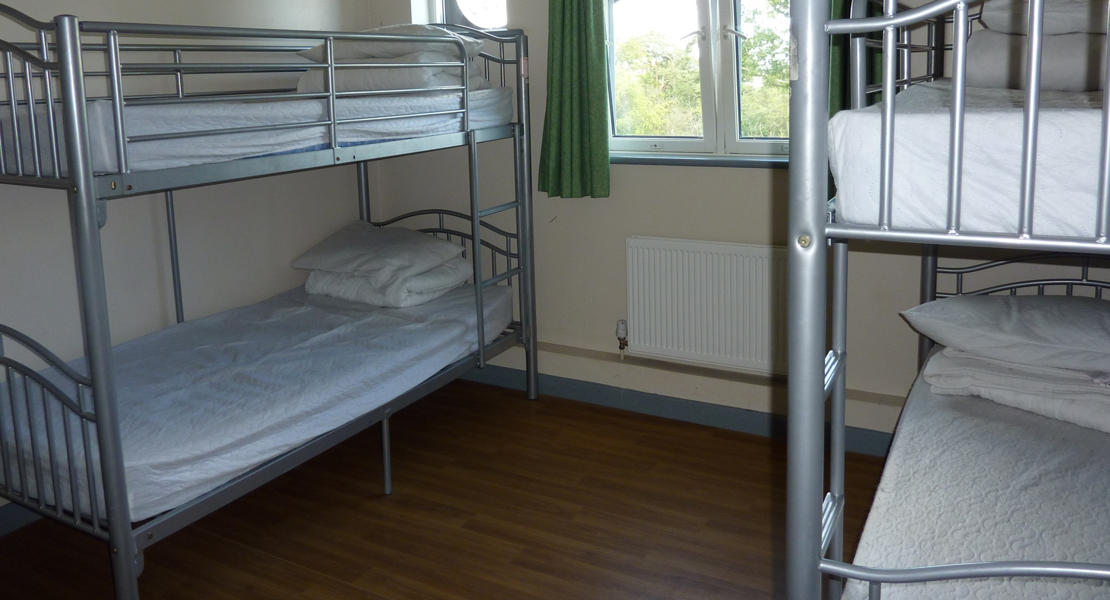
Your Bedroom

Slide 8
A Typical Day
7.15am wake-up
Room inspection
8:00 Breakfast
8:45 – 12:00 Morning activity sessions
12:30/12:45 Lunch
1:30 – 4:45 Afternoon activity sessions
5:30 Dinner
Evening activity
Free time e.g. playing games or reading
Hot chocolate & story
Lights out by 9.00

Slide 9
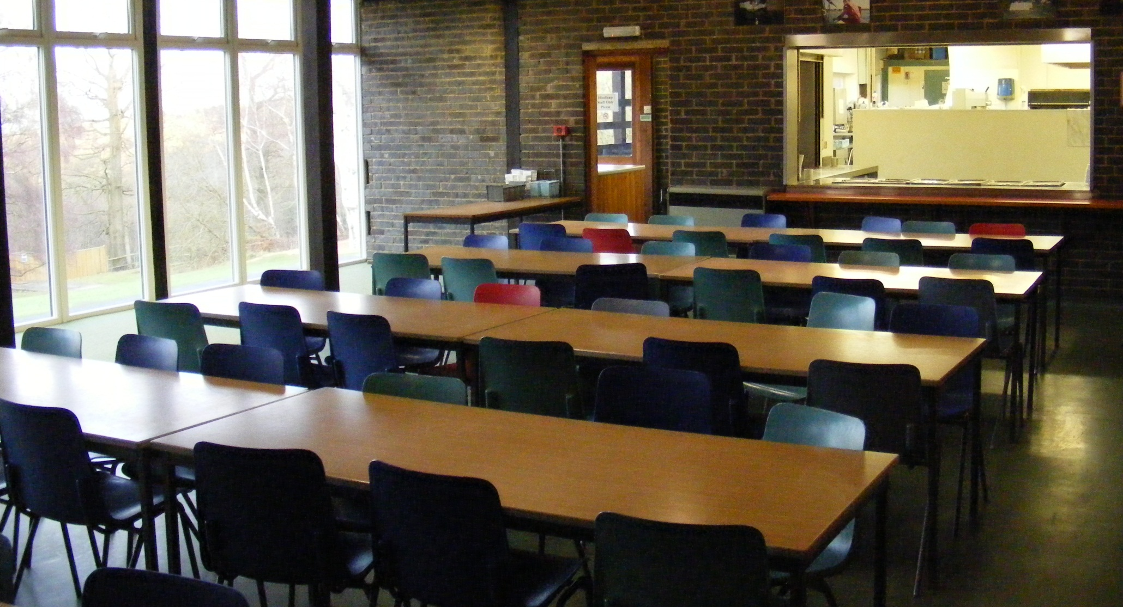
The Dining Room

Slide 10
Other Information
Special meal requirements
Please ensure that any special meal requirements are made clear on the medical form so that we inform Hindleap Warren in advance to ensure alternatives or total avoidance. The medical form will go out in September so that we have up to date information.

Slide 11
Activities
I will now be briefly going through some of the activities that other children have taken part in. However there is no guarantee of activities yet as I am yet to finalise these with Hindleap Warren.

Slide 12
Activities
Abseiling and Zip Wire
At Hindleap Warren they do their abseiling and zip wire from a specially constructed platform in a tree. This exhilarating activity requires individuals to commit to trusting the equipment and the instructor. They also build togetherness within the group as the young people encourage each other.
Archery
This activity is about skill acquisition. It is possible to progress rapidly and by the end of the session be able to hit the target with reasonable accuracy. The importance of listening to and following instructions and the need to follow safety procedures are key parts of this activity.

Slide 13
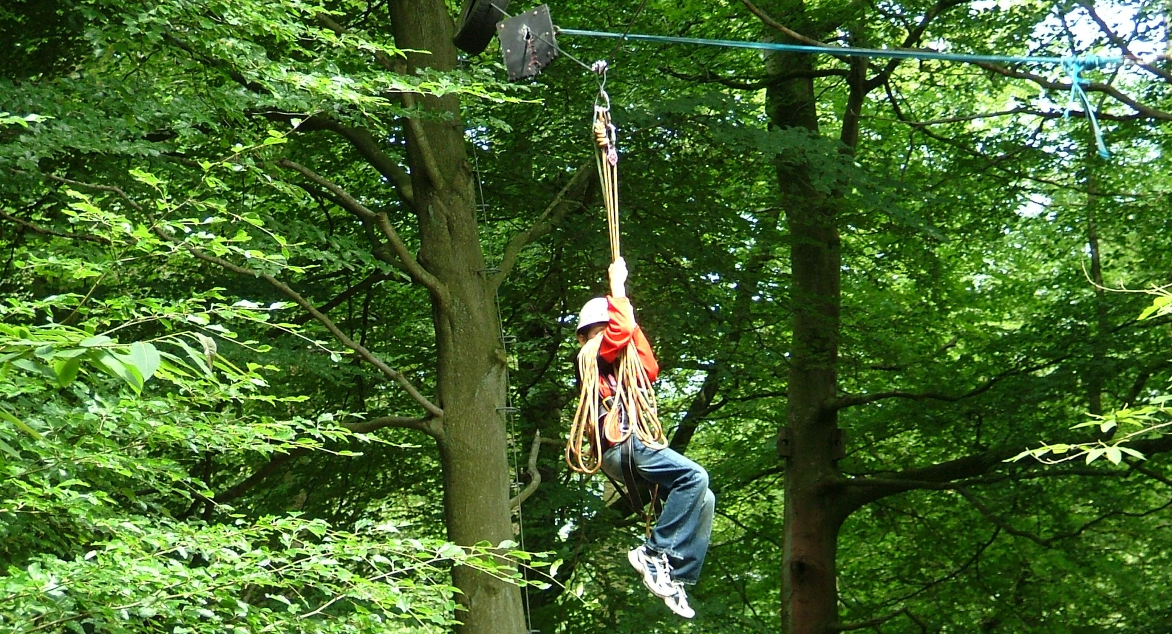
Zip Wire

Slide 14
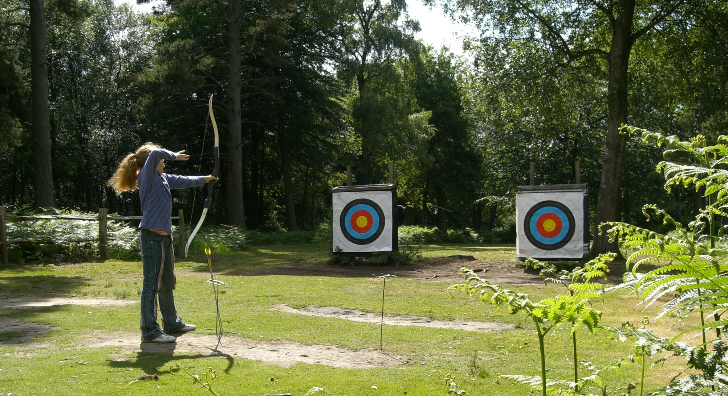
Archery

Slide 15
Activities
Bushcraft
The session starts with an introduction to the basic elements of wilderness survival. The creation of a debris shelter is next, built from anything found lying around the forest. This is followed by a fire lighting display with the children having a chance to set their own fires using a flint and steel or a bow drill.
Climbing Wall
Hindleap Warren has a purpose-built climbing wall. This session provides the opportunity for individuals to challenge themselves as well as emphasising effective teamwork.

Slide 16
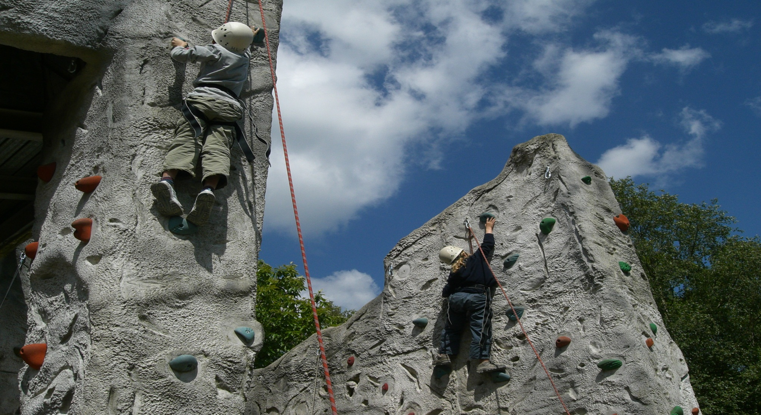
Climbing

Slide 17
Activities
Forest Adventure
This activity takes the form of a mini expedition through Hindleap’s 300 private acres during which the group has to travel through difficult terrain, such as streamways and thick undergrowth.
High Adventure
For this session the group undertake a variety of challenges up in the trees. At all times the safety rope is managed by the instructor, so the participant is completely safe, however, their perception of danger is a valuable learning experience.

Slide 18
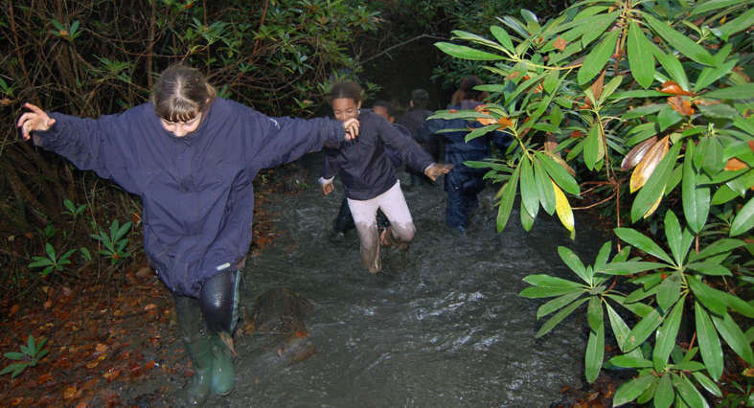
Forest Adventure

Slide 19
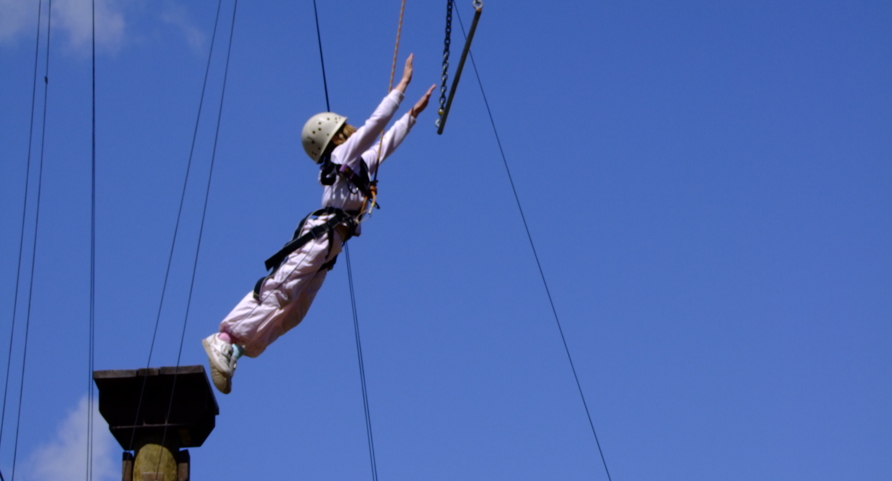
High Adventure

Slide 20
Activities
Map Reading and Orienteering
This starts with an indoor theory session followed by an opportunity for small groups to put skills learnt into action and complete a full orienteering course.
Obstacle Courses
During this session the group will encounter a series of obstacles, which include a low rope course, tunnels, scramble nets, string trails and lots of mud! The challenges are physical in nature and require determination, good teamwork, and a sense of fun.

Slide 21
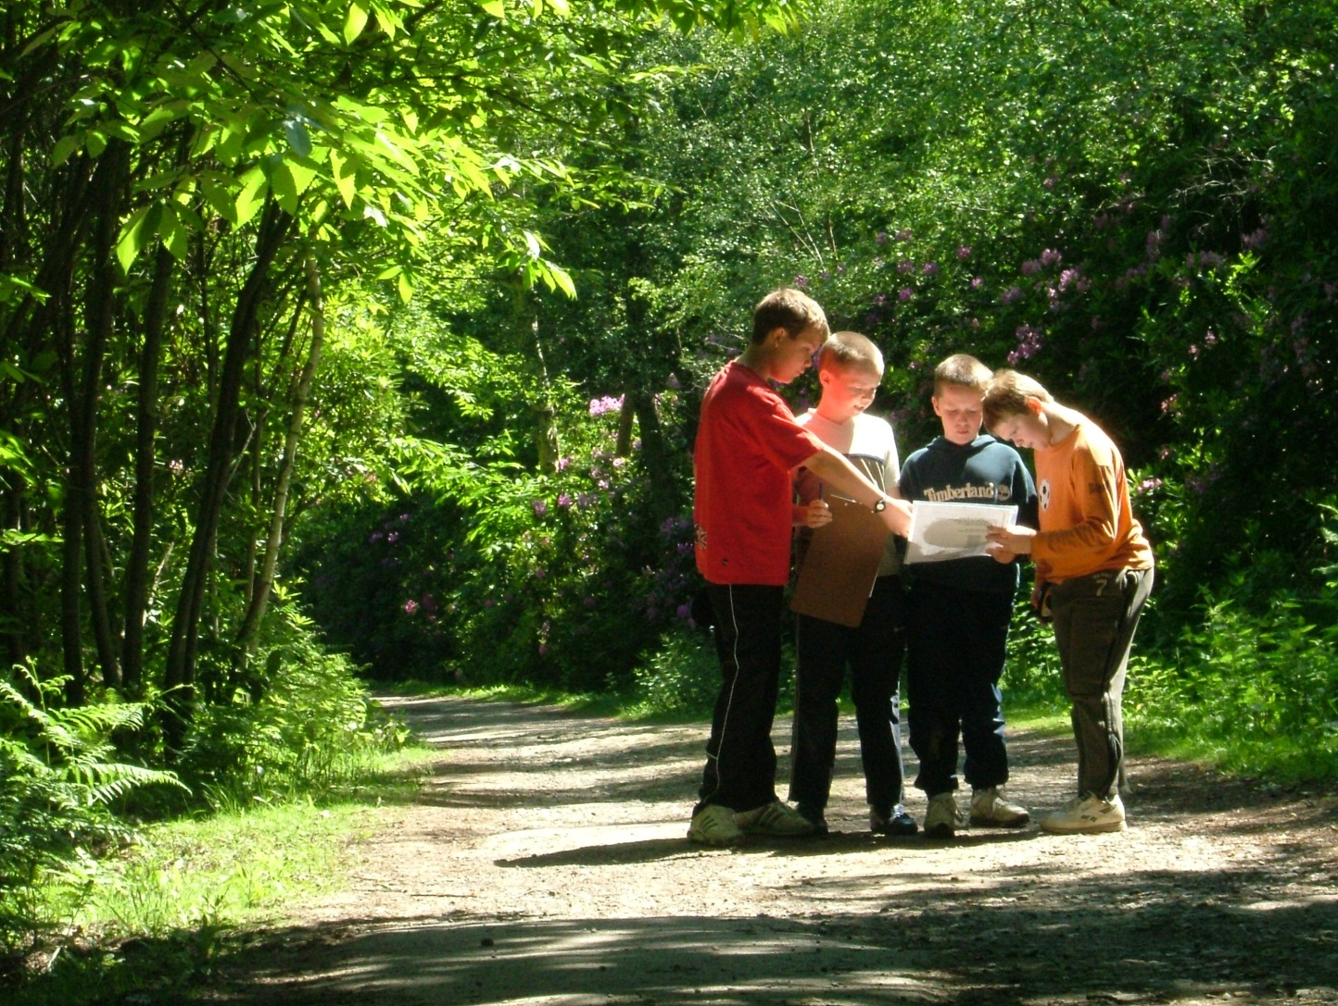
Map reading and orienteering

Slide 22
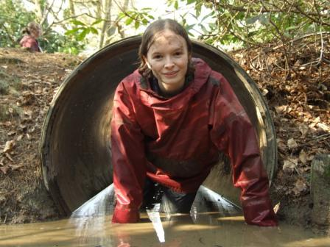
Obstacles

Slide 23
Activities
Team Exercises
The aim of this activity is to develop an understanding of the importance of teamwork. The group is presented with a series of problem-solving exercises which are carefully selected by the instructor who ensures that everyone in the group plays a full part.
Team Challenge
This is often the final session of the residential and is a friendly competition between all groups. Planning is a key feature, as the group has a limited amount of time to select and complete a variety of problem-solving tasks; the harder the task, the higher their score.

Slide 24
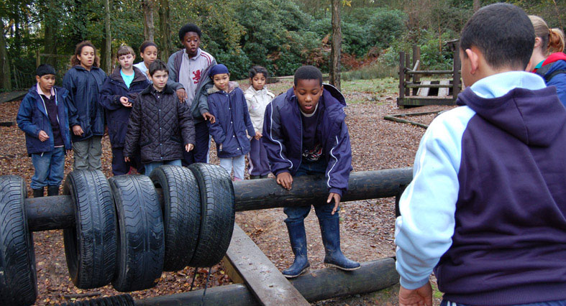
Teambuilding Exercises

Slide 25
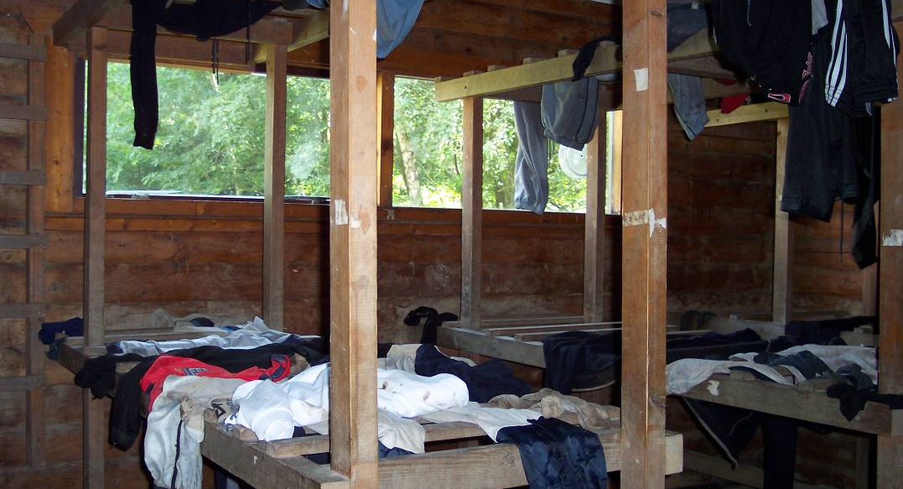
The Drying Room / What to bring

Slide 26
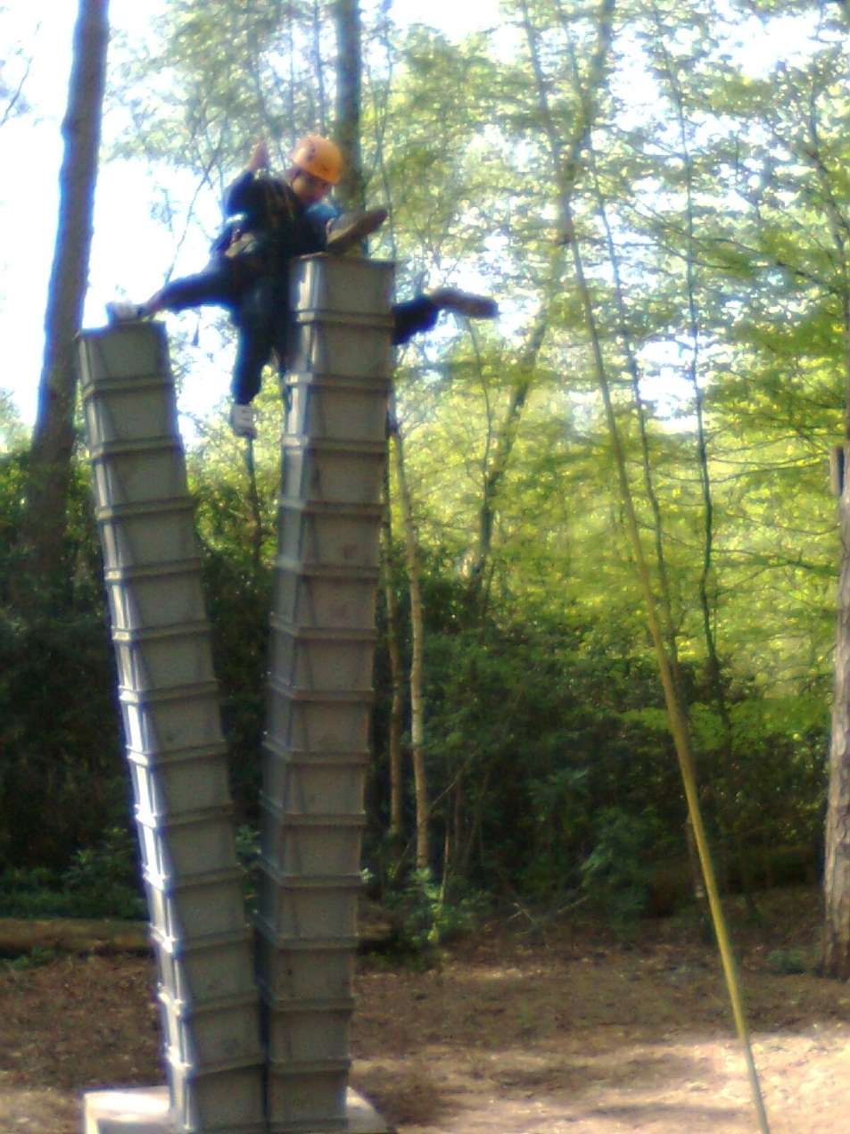
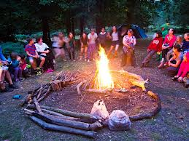

Slide 27
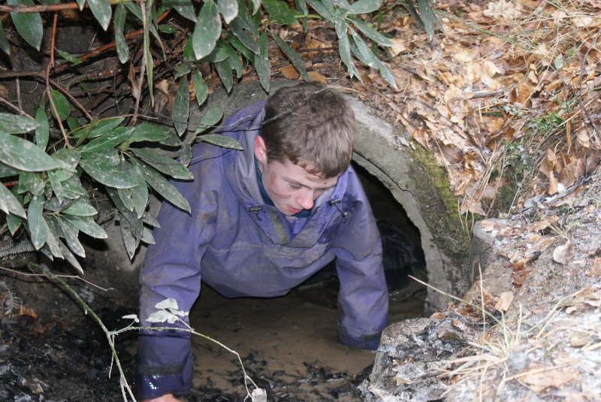

Slide 28

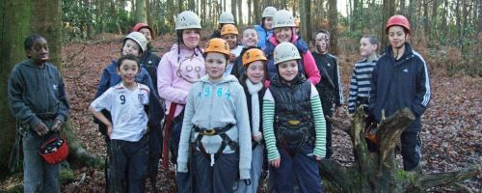

Slide 29
Costs
The cost will be £254. The cost includes coach travel, all meals, accommodation and at least three different activities a day (as well as an evening activity).
You can begin making payments immediately, but we would ask that you make a deposit of £50 by Friday, 29th March to confirm your child’s place. Please enclose the slip below with your cash deposit (or indicate that you have paid online).
Further payments will be due as follows:
£50 by 24th May
£50 by 19th July
£50 by 6th September
£54 by 18th October
You can, of course, pay online and may make payments as frequently as you like, spreading the cost over time even more than the schedule above, or in one payment.

Slide 30
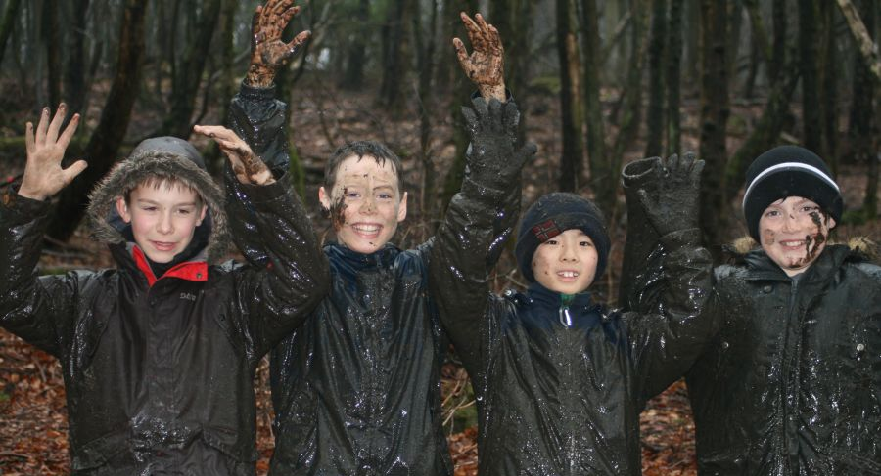
A Lasting Impression

