Slide 1
Year 6 Kingfishers

Slide 2
Aims:
Weekly timetable
Reading Challenge, Read Theory and Top 100 books
Home learning
Parent helpers
School Journey
SATs
Secondary transfer information
Questions

Slide 3
Weekly timetable
 | 8.55 - 9.00 | 9.00-10.00 |  | 10.00-10.45 | 10.45 – 11.00 | 11.00 - 12.15 |  |  | 12.15 – 1.15 | 1.15 – 2.45 |  |  |  | 2.45 – 3.00 | 3.00 – 3.15
Monday | Registration | Spelling test | Stride Enterprise/Spelling and Reading |  | Playtime | Maths |  | Change for PE | Lunch | Reading/PSHE 1:15 - 2 |  | Leadership time Ryan PE and Laura Arithmetic test |  |  | Assembly
Tuesday | Registration | SPaG |  | Writing | Playtime | Maths |  |  | Lunch | French 1:15 – 1:45 | Music 1:45 – 2:15 |  |  | Geography/History
Wednesday | Registration | Reading |  | Writing | Playtime | Maths and TT Rockstars |  |  | Lunch | Science |  |  |  |  | Assembly
Thursday | Registration | Writing |  | SPaG | Playtime | Maths | Change for PE |  | Lunch | Ryan PE |  |  | Laura Art/D and T/R.E. |  | Assembly
Friday | Registration | Reading |  | Writing | Playtime | Maths and TT Rockstars |  |  | Lunch | Computing |  |  | Spelling | Assembly | Read/home learning

Slide 4
Reading Challenge

Slide 5
Suggested 100 books to read by Year 6
There is a real buzz in the class around reading which is
fantastic!
I want to encourage the love of reading for many reasons:
It is a wonderful thing to do!
It is a life skill and transferable across all subjects
To improve the children’s vocabulary (this is always an area for improvement in the SATs reading paper)
To improve the children’s writing
To improve the children’s spelling
Please can you help us in encouraging children to read daily and to get their reading records signed. Please also ask your children questions about what they are reading to ensure understanding.

Slide 6
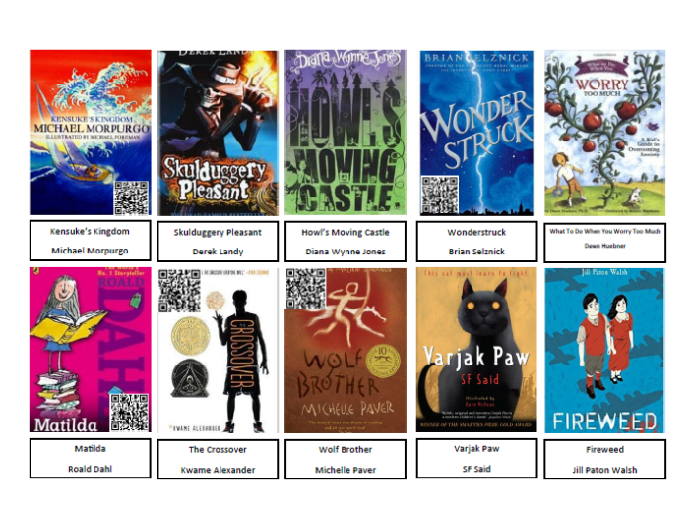

Slide 9
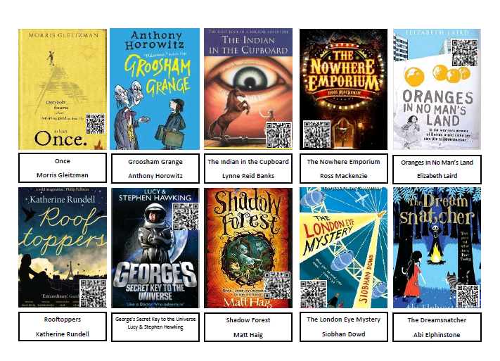

Slide 11
Home learning
Home learning will be given out by Friday. You can also find the home learning sheet uploaded on the school website by Wednesday (on our class page).
We will have a spelling test every Monday morning. Every fortnight the children will repeat the arithmetic test.
Please also focus on times tables (the new curriculum expectation (as of 2014) is knowing up to 12x12 by end of year 4..!). The children should know their own personal maths target. The children will be tested on their individual times table target twice a week (currently every day as a refresher). We are also trialling a new timestable website/app called Times tables Rockstars. Your child has been given a log in and can practise at home!
Please also talk to your child about the time and ask them what the time is (both analogue and digital clock). E.g. ‘You can watch TV for 15 minutes. What time do you have to turn it off?’

Slide 12
Parent helpers/class reps
Readers/maths target practice
Trip helpers (with up to date Richmond DBS check)
Christmas fair (stall)
Year 6 disco (July)
Summer fair (stall)
Year 6 fundraising e.g. bake sale

Slide 13
School Journey – Hindleap Warren
Monday 29th October 2018 – Friday 2nd November 2018
On Monday, please meet us in the hall at 8:45am with suitcase/holdall (that your child can carry independently) and any medical items in a clear, labelled bag (handed to Faith Polya). We aim to be back to school in time for normal pick up on Friday.
The equipment list is to be taken home today. Basically…bring layers and OLD clothes, some bin bags for dirty clothes, toiletries and NO electrical items.
The medical form is also to be taken home today. Please include any dietary requirements as I will need to pass this information on to the caterers at Hindleap Warren. This must be returned to school by Friday 12th October.

Slide 14
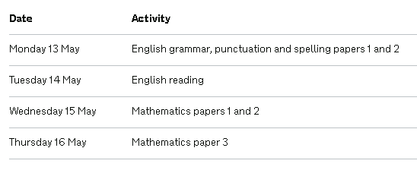
SATs
SATs week
Monday 13th May 2019 – Thursday 16th May 2019

Slide 15
Applying for a place at a secondary school for September 2019
Apply online: easy, quick, secure, reliable – 97.6% of parents applied on line last year; or
Complete the paper Common Application Form
List up to 6 preferences for maintained schools or academies in or out of the borough
Submit by the closing date of 31 October 2018

Slide 16
Key dates
27 September 2018 – start of Richmond secondary schools’ open evenings
31 October 2018 – closing date for applications
19 October 2018 – ideally submit before half term
1 March 2019 – National Offer Date. Online applicants receive outcome by email and your LA sends you a letter giving outcome of your application

Slide 17
Summary
Visit schools to gather information and make an informed decision
Apply online at www.richmond.gov.uk where there is a link via the school admissions page or direct via www.eadmissions.org.uk
Submit your application by 31 October 2018
Submit supplementary forms direct to the schools
Order of preference in which you place schools is very important

Slide 18
Queries and Further Information
Richmond’s Schools Admissions Team Tel: 020 8547 5569
Email: richmond.admissions@achievingforchildren.org.uk

