Slide 1
Year 6 Parents’ meeting 2018

Slide 2
Aims:
SATs
Key dates for the diary

Slide 3
In the summer term of 2018, children in Year 2 and Year 6 will be the third year group to sit the ‘new curriculum’ SATs papers. These tests in English and maths will reflect the new national curriculum, and are intended to be more rigorous. At the end of Year 6, children will sit tests in:
Reading
Maths
Spelling, punctuation and grammar
These tests will be marked externally, and the results will be used to measure your child's progress and the school's performance. Your child’s marks will be used in conjunction with teacher assessment to give a broader picture of their attainment.

Slide 4
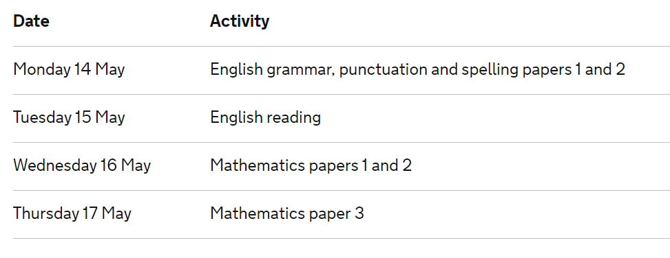
SATs week 2018

Slide 5
Key Stage 2 grammar, punctuation and spelling test
The grammar, punctuation and spelling test will consist of two parts: a grammar and punctuation paper requiring short answers, lasting 45 minutes (total of 50 marks), and an aural spelling test of 20 words (total of 20 marks), lasting around 15 minutes.
The grammar and punctuation test will include two sub-types of questions:
Selected response, e.g. ‘Identify the adjectives in the sentence below’
Constructed response, e.g. ‘Correct/complete/rewrite the sentence below,’ or, ‘The sentence below has an apostrophe missing. Explain why it needs an apostrophe.’

Slide 6
Key Stage 2 Reading
The reading test will be a single paper with questions based on one 800-word text and two passages of 300 words. Your child will have one hour, including reading time, to complete the test.
There will be a selection of question types, including:
Ranking/ordering (often summarising), e.g. ‘Number the events below to show the order in which they happen in the story’
Find and copy (often linked to word meaning), e.g. ‘Find and copy one word that suggests what the weather is like in the story’
Short constructed response (fact retrieval), e.g. ‘What does the bear eat?’
Open-ended response (inference, prediction and comparison-style questions), e.g. ‘Look at the sentence that begins Once upon a time. How does the writer increase the tension throughout this paragraph? Explain fully, referring to the text in your answer.’

Slide 7
Key Stage 2 maths
Children will sit three papers in maths:
Paper 1: arithmetic, 30 minutes (written) (40 marks)
Papers 2 and 3: mathematical fluency, solving problems and reasoning, 40 minutes per paper (total of 70 marks – 35 marks per paper)
Paper 1 will consist of fixed response questions, where children have to give the correct answer to calculations, including long multiplication and division.
Papers 2 and 3 will involve a number of question types, including:
Multiple choice
True or false
Constrained questions, e.g. giving the answer to a calculation, drawing a shape or completing a table or chart
Less constrained questions, where children will have to explain their approach for solving a problem.

Slide 8
How will Key Stage 2 SATs be marked?
The old system of national curriculum levels is now no longer used, after the department of education abolished it in Summer 2015. Instead, children will be given standardised scores.

Slide 9
Raw and scaled scores
Raw scores are the score they get (out of 40 or 50) for the tests
Scaled scores are used all over the country. They help test results to be reported consistently from one year to the next.
For example, on our scale, 100 will always represent the ‘national standard’. However, due to the small differences in difficulty between tests, the ‘raw score’ (ie the total number of correct responses) that equates to 100 might be different (though similar) each year.
A pupil’s scaled score will be based on their raw score. The raw score is the total number of marks a pupil receives in a test, based on the number of questions they answered correctly. The pupil’s raw score will be translated into a scaled score using a conversion table. A pupil who achieves the national standard will have demonstrated sufficient knowledge in the areas assessed by the tests. This will mean that they are well placed to succeed in the next phase of their education.
You will be given your child’s scaled score, alongside the average for their school, the local area and nationally.

Slide 10
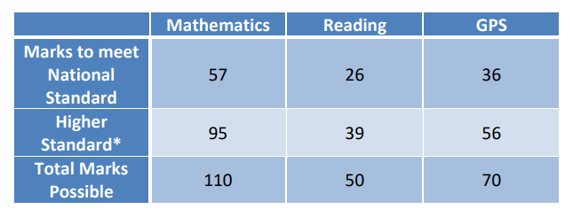

Slide 11
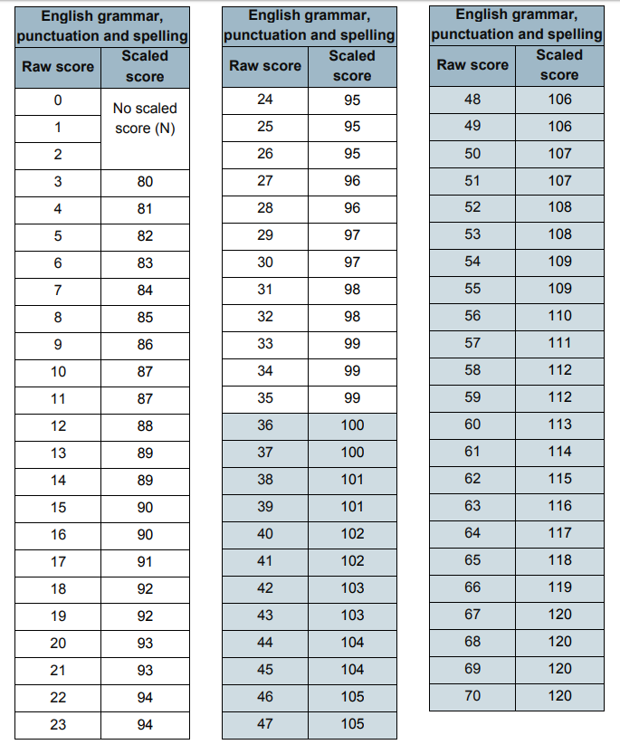
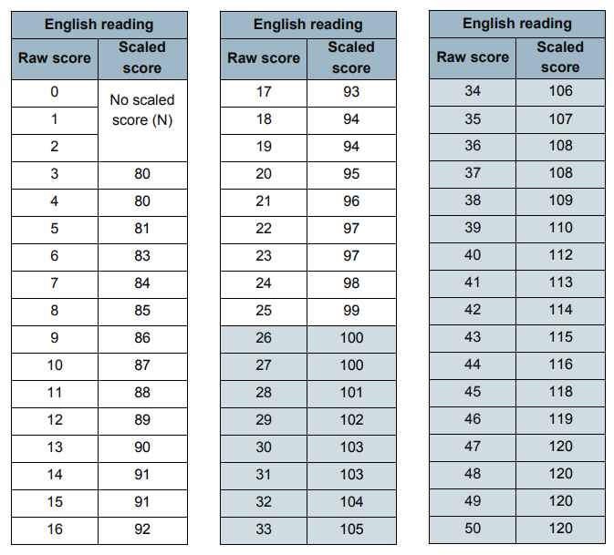

Slide 12
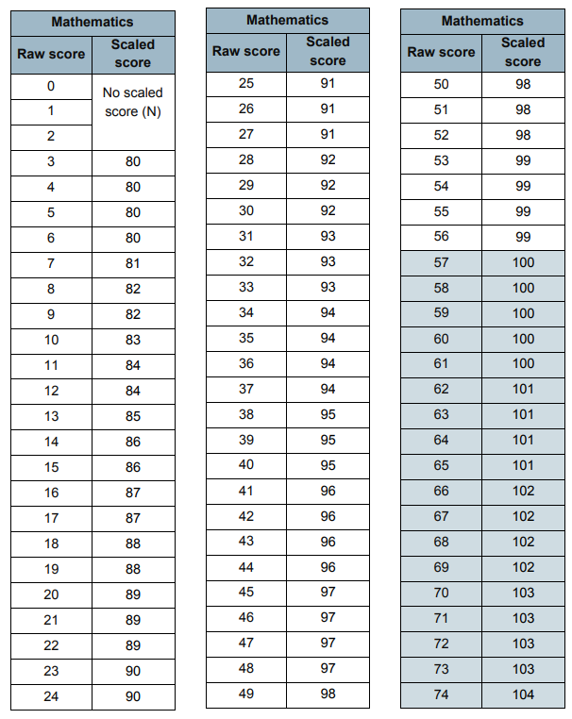
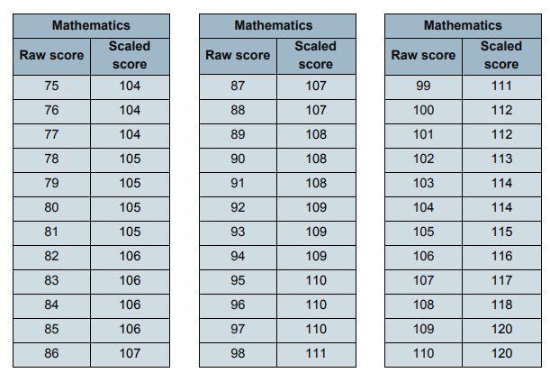

Slide 13
SATs breakfast
Our Darell tradition is to invite all Year 6s in to school from 8:15am for a special SATs breakfast (choice of cereals and toast).
This is a lovely way to start the day – not only to ensure that every child has breakfast but it also means that all the children are together in school, on time and it allows them to feel less anxious about the SATs test that day.
A letter will follow closer to the time.

Slide 14
Mock SATs week – W/C Monday 26th March
Monday – SPaG
Tuesday – Reading
Wednesday – Arithmetic (Paper 1) and Maths Paper 2
Thursday – Maths Paper 3
This is to mirror SATs week so that the children know exactly what it will be like (where they will do the test, with which adult etc).
However, we WON’T be offering SATs breakfast!

Slide 15
What can you do to help?
Reading daily – ask your children questions about what they are reading e.g. what do you predict will happen next? How is …… feeling? What makes you think that? Is this book similar to another book that you have read? Why?
We do maths assessments weekly and reading/SPaG assessments frequently, which the children are encouraged to take home. Please speak to your child about these. You could ask them what they found difficult and which areas they need help with.
Times tables
Telling the time
Learning spellings for home learning – we learn/revise a different spelling rule each week.
Please do not complete any past papers at home as we are doing them in school and it then means that I may miss any gaps that the child might have as they have memorised the answers!

Slide 16
Dates for the diary…
W/C Monday 25th June – Cycling Proficiency Week
Your child needs a bike and a helmet. If they do not have these, please organise for them to borrow from a friend or family member of a similar size. A letter will follow with more details after Easter.

Slide 17
Year 6 disco – Tuesday 17th July 2017 6:00pm - 7:30pm We will be asking families for a donation of £3 and ‘party food and drinks’ and then for a couple of volunteers to help run the disco (sorting out the food and drink, helping to tidy up etc!). A letter will go home in the summer term.

Slide 18
Yearbook – please send in your photos for your child’s year book page. This can be individual photos (old and current – no more than 5!) and group photos with friends (including old class pictures!). Please email your photos to info@darell.richmond.sch.uk with the Subject: Year 6 Yearbook photos. The deadline is the Easter holidays.

Slide 19
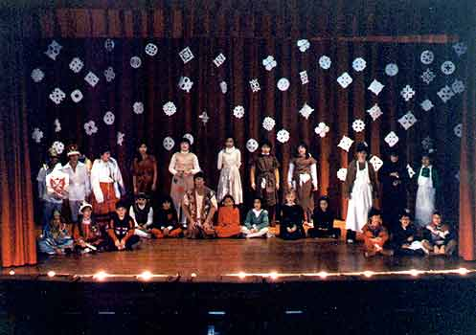
Year 6 production
Afternoon performance/dress rehearsal – Thursday 12th July 1:45 – 2:45pm
Evening performance – Monday 16th July 6:30 – 7:30pm
Leavers’ assembly – Friday 20th July 9 - 9:30am

Slide 20
Any questions?

